Slide 1

Subscribe to DeepL Pro to edit this document.
Visit www.DeepL.com/pro for more information.

Slide 2
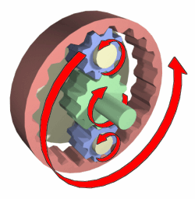
Gear Training
About Gear, About
Types of Gear・ Gear Name
Accuracy of Gears
Gear Material・HT・Strength
About Gear Machining
Kyushu Musashi Seimitsu Co.
Production Engineering Section, Engineering Department
willow field
2021-04-12
Cited Materials Intermediate Gear Study Group
KHK Gear Materials

Slide 3
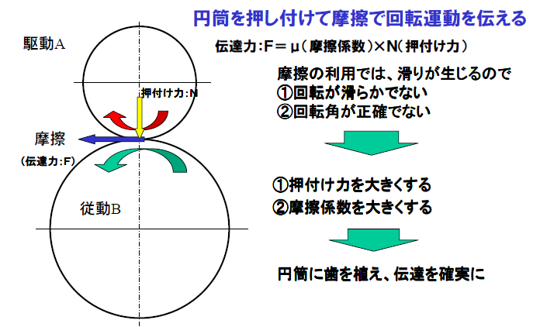
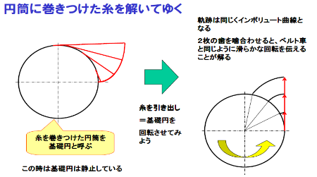
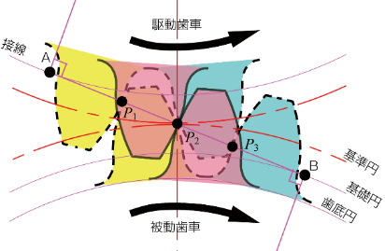
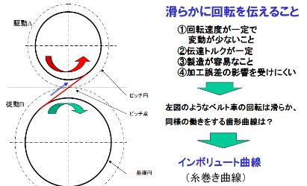
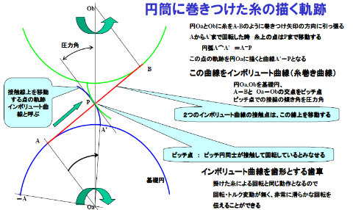
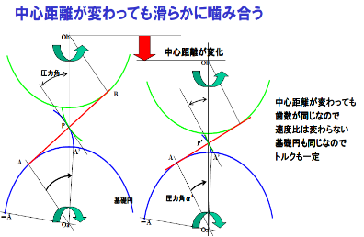
Gears are the
Transmission of rotational motion
What is an involute curve?
Gear Meshing
What gears need.
Meshing of two involute curves
Center distance of meshing gears

Slide 4
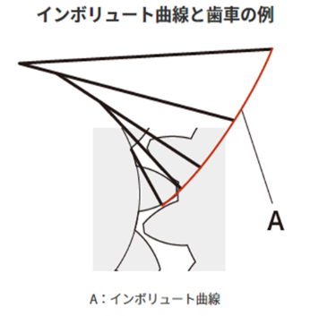
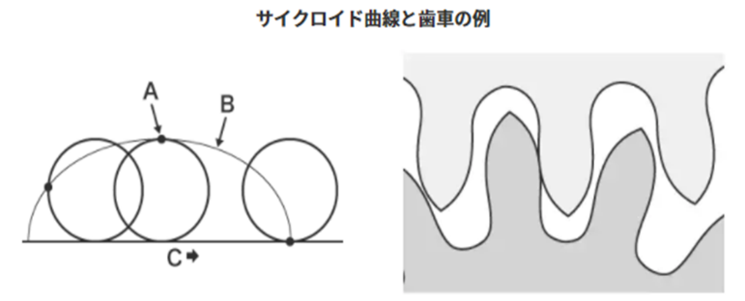
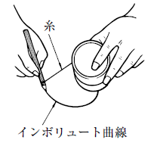
Tooth Profile Curve
Involute tooth profile
cycloidal tooth profile
This is a tooth profile with a shape known as an involute curve.
An involute curve is the curve drawn by the tip of a thread when it is wrapped around a cylinder and unrolled without loosening.
The main advantage of gears with involute tooth profile is that the error in the center distance of the gear does not affect the rotational accuracy and meshing. In addition, the pressure angle is constant from the beginning to the end of meshing, allowing for smooth operation with minimal wear. In addition, involute tooth profile gears are simple in shape, easy to machine, and inexpensive, which is why they are used in many equipment gears.
This is a tooth profile with a shape known as a cycloid curve. A cycloid curve is the trajectory drawn by a single point of a circle as it rolls on a straight line. The cycloid curve, inverted upside down, is also known as the curve where an object slides down the fastest.
The advantage of the cycloid tooth profile is that it is stronger than the involute tooth profile because the area around the tooth is larger. The most important advantage is that there is no interference between the teeth.
Gears with cycloid tooth profile are used in low-load products such as watches and precision machinery because of their features such as "wide tooth flanks and no slippage in the tooth profile" and "low rotational resistance due to complete rolling.
How to draw an involute curve

Slide 5
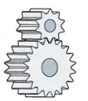

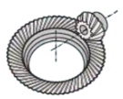
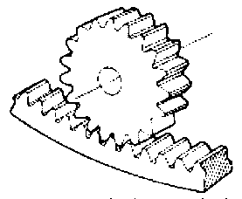

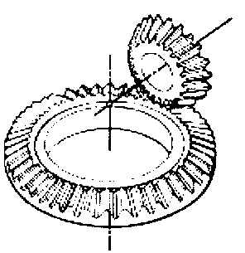
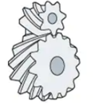

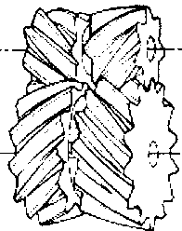
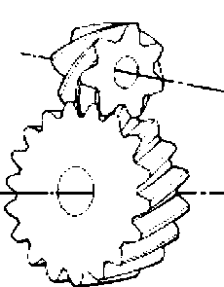
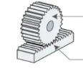

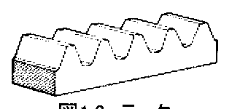
Types of gears
(1) Parallel shaft gears
(2) Gears on crossed axes
(1) Spur gear
It has teeth that are parallel to the shaft. Most common and widely used, spurge
(also known as spur gear), is the movement between two parallel axes.
and the rotation is in the opposite direction of each other. (Figure 1-1)
(1) Quick Bevel Gears
Also known as straight bevel gears, these are gears that run along the base line of a cone.
It has straight teeth that contract toward a point. (Figure 2-1)
Fig. 2-1 Bevel gears
Fig. 1-1 Spur gears
2) Spur gears
Also called spiral bevel gears, spiral bevel gears are gears with helical teeth.
The teeth of the bevel gears are spiral-shaped to obtain smooth rotation by making the
The spiral bevel gears are also called spiral bevel gears. The rotation is smooth, the noise is low, and the speed is high.
It is suitable for rotation. It is also possible to increase the tooth ratio. (Figure 2-2)
(2) Internal gear
Also called internal gears, these gears have teeth cut into the inside of a cylinder.
The direction of rotation of the two axes will be the same.
The number of rotations between the two shafts is inversely proportional to the number of teeth on both gears. (Figure 1-2)
Fig. 2-2 Spinning bevel gears
Fig. 1-2 Internal gears
3) Zerol bevel gears
A spiral bevel gear is one in which the torsion angle is zero. Straight bevel gears and spiral bevel gears
This is a unique bevel gear that combines the characteristics of gears, and the force applied to the teeth is immediately applied to the bevel.
It is the same as a car. (Figure 2-3)
3) Helical gears
Helical gears are also called helical gears.
The teeth are cut so that engagement begins at one end of the tooth, resulting in smooth rotation.
Less noise, suitable for high rotation, and stronger teeth than spur gears.
However, since the teeth are inclined at an angle, axial force (thrust force) is generated. (Figure 1-3)
Fig. 2-3 Zerol bevel gears
(3) Gears with misaligned shafts
Cylindrical worm gears
The two axes are perpendicular to each other and consist of a threaded worm and a worm wheel that meshes with the worm.
The meshing is sliding contact. Its engagement is sliding contact, so there is almost no noise. Rotation
As a result, it is used in applications that require large deceleration. (Figure 3-1)
Fig. 1-3 Helical gears
4) Yamaba Gear
Helical gears are subject to axial forces, so in order to eliminate these forces, two
A double helical gear is a combination of helical gears with their teeth facing in opposite directions.
(It is also called a dovetail helical gear. It is also called dovble helical gear.
In addition to being able to transmit a large amount of power, it does not generate any axial force (thrust force). (Figure 1-4)
Fig. 3-1 Spur gears
(2) Screw gears
Helical gears have two intersecting shafts, and are used to change the direction of the rotating shaft.
Also known as spiral gears. Screw gears have a point contact meshing
Therefore, care must be taken to avoid rattling due to wear when large transmission forces are applied.
(Figure 3-2). (Figure 3-2)
-3-
Fig. 1-4 Helical gears
Fig. 3-2 Internal gears
5) Rack
A rack is a spur gear with a pitch circle radius of infinity. (Figure 1-5)
Hypoid gear
It can be thought of as a bevel gear with a misaligned spiral bevel shaft, and the amount of misaligned shaft.
Since the pinion shaft can be moved, the shaft can be extended. As the rear-wheel drive of an automobile
It is often used. (Figure 3-3)
Figure 1-5 Rack
Fig. 3-3 Helical gears

Slide 6
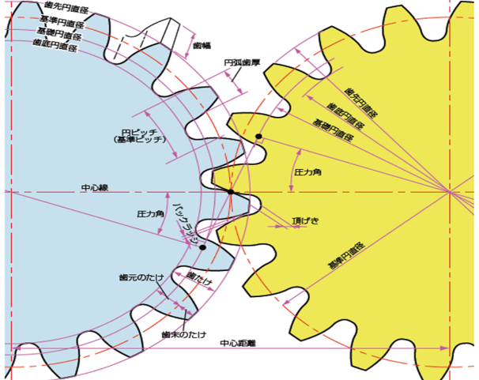
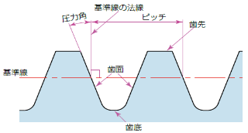
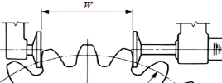
Names of Gear Parts
(1) Center distance (center distances)
The distance between the centers of a pair of gears when they are meshed.
This is also called the distance between axes.
⑩ Base circle diameter
The diameter of the underlying circle on which the involute tooth profile is made.
3
Front normal pitch
11
(2) Circular pitch
Correspondence of adjacent teeth measured on the pitch circle or on the pitch line
Minutes away.
Tooth tip circle diameter
The diameter of the circle connecting the tips of the teeth.
12
2
Normal pitch
In involute gears, the common vertical line between tooth profiles of a specific cross-section
The pitch measured along the The specific cross section is usually the front face or plane of action.
Tooth base circle diameter
The diameter of the circle passing through the root of the tooth.
10
effective tooth mushroom
(4) Whole depth
Length of the entire tooth in the direction of the tooth bamboo, the sum of the bamboo at the end of the tooth and the bamboo at the base of the tooth
Equal.
⑬ Tooth thickness
The thickness of a tooth on the pitch circle, including arc thickness, string thickness, and straddle thickness.
thickness, etc.
i) Circular thickness
The thickness of a single tooth is expressed as the length of the arc on the pitch circle.
ii) chordal thickness
It is expressed as the length of the string between two symmetrical points on both sides of the tooth surface on the pitch circle.
III) Thickness of straddle teeth (displacement over a given number of teeth)
In involute gears, the tooth thickness when measured across several teeth with a parallel measuring strip.
5
8
(5) Effective tooth mushroom (working depth)
The sum of the bamboo at the end of the teeth of a pair of gears.
4
9
7
(6) Bamboo at the end of the tooth (addendum)
Difference between the radius of the pitch circle and the tip circle of the gear
6
(7) Dedendum (the bamboo at the base of the teeth)
Difference between the radius of the pitch circle and the base circle of the gear
1
14
13
⑧ Ting Geki (clearance)
The distance from the tooth base circle of the gear to the tooth tip circle of the gear that meshes with it.
Pressure angie
At a point on the tooth surface, the radial line and the tangent line to the tooth profile are not connected.
angle, which usually means the pressure angle at the pitch point.
Tooth thickness
⑨ Pitch circle diameter
The circle that serves as a reference when determining the dimensions of a gear is called the reference pitch.
Its diameter.
base circle

Slide 7
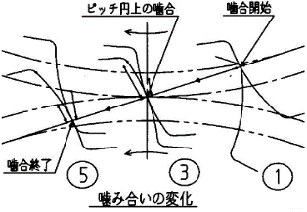
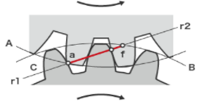
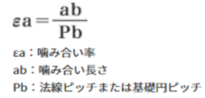
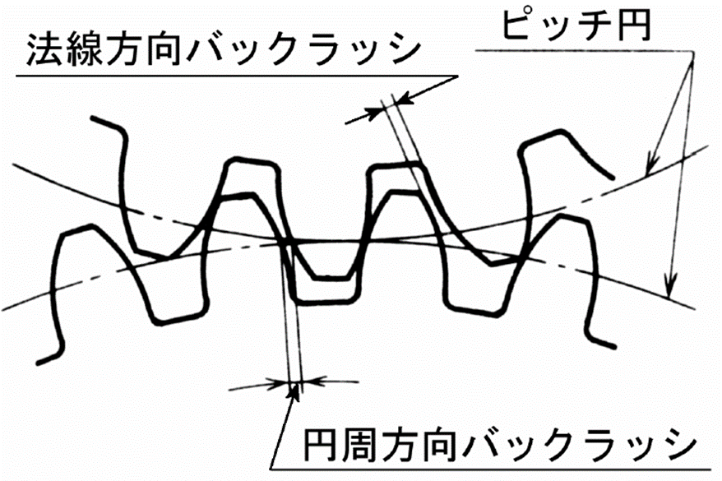
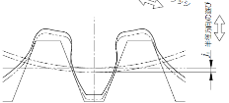
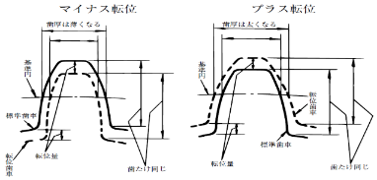
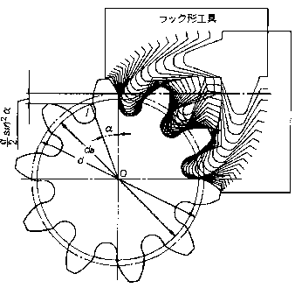
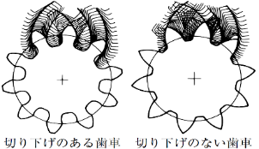
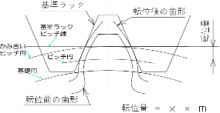
Names of Gear Parts
(15) Contact ratio
The rate of engagement is a criterion for determining whether a pair of gears is engaging correctly.
It is a thing.
Gear meshing starts at the meshing start point S1 and ends at the meshing end point S2.
The end lengths S1 and S2 are called the interlocking lengths.
The engagement ratio is the value obtained by dividing this length by the normal pitch, and in general, an engagement ratio of 1.4 or higher is required.
It's been said.
S1
S2
Engaging length
⑯ Backlash (backlash)
Backlash is the play or gap between the tooth flanks of gears when they are meshed.
The backlash amount can be reduced by decreasing the tooth thickness or by changing the center distance.
This is the first time I've done this.
17 Dislocation
In order to prevent undercutting, the pressure angle, the end of the tooth, and the bamboo at the base of the tooth are not set to standard values.
There are two types of gears. For example, if the cutting depth of the blade is made shallow and creative gear cutting is performed, gears with a lower than standard gear set can be produced.
The deeper the depth of cut, the larger the tooth edge will be. On the contrary, the deeper the incision, the larger the tooth base will be than the standard value. This kind of tooth
The car is called a dislocation gear. The reference pitch line of the rack type tool is shifted outward from the reference pitch circle of the gear.
The method of gear cutting is called positive dislocation, in which the rack-shaped tool is driven into the standard position for gear cutting.
The method is called negative rearrangement.
In addition to preventing devaluation, one of the important purposes of dislocating gears is to change the tooth thickness, center distance, and other factors.
It can meet a variety of requirements.
In forward gears, the tooth surface is twisted, which increases the strength, but the tooth tip tends to pointy.
Negative dislocation gears have lower strength because the tooth surface wakes up, but they are advantageous for gear noise.
Creation of standard gears
Dislocation coefficient
mainly
When you want to intentionally change the center distance to a specified one.
2. when you want to avoid cutting down the tooth profile

Slide 8
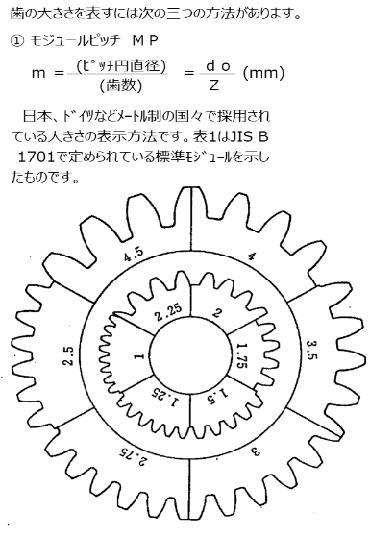
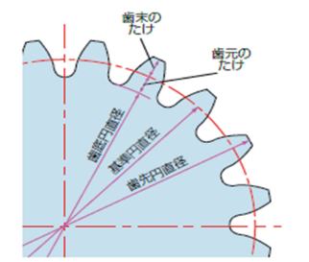
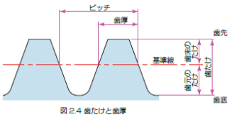
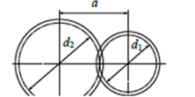
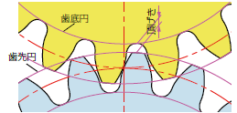
Size of gears
Tooth Growth and Thickness The height of the tooth is determined by the size of the module (m), which is specified in ISO and JIS. Fig. 2.4 Tooth Profile (Parallel Tooth) Fig. 2.4 Tooth Length (h)/End Tooth Length (ha)/Base Tooth Length (hf)
Tooth length (h) is the distance from the tip of the tooth to the bottom of the tooth. h = 2.25m (length at the end of the tooth + length at the base of the tooth)
The length of the end of the tooth (ha) is the distance from the tip of the tooth to the reference line (pitch circle). ha = 1.00m
The length of the tooth base (hf) is the distance from the tooth base to the reference line (pitch circle). hf=1.25m
Tooth thickness (s) is based on half of the pitch (p) Pitch (p) = πm s=
Gear diameter (size) The size of the gear is based on the reference circle diameter (d). The pitch, tooth thickness, tooth length, tooth end length, and tooth base length are determined based on the reference circle. Reference circle diameter (d)
d=zm Diameter of tooth tip circle (da) da=d+2m Tooth base circle diameter（df) df=d-2.5m
Center distance and backlash When a pair of gears mesh so that their reference circles are tangent, the center distance is half the diameter of the two reference circles. Center distance (a) a=
Backlash (play between tooth surfaces) is important for smooth meshing of gears. Backlash refers to the play between the tooth flanks of a pair of gears when they are meshed. There is also a gap (play) in the tooth length direction between gear pairs. This is called the clearance. The clearance (c) is the difference between the length of the tooth root of the gear and the length of the tooth end of the mating gear. apex attack (c) c=1.25m-1.00m=0.25m
(d1+d2)
2
pi m
Circular pitch CP
2
t = 0
Π × (pitch circle diameter)
=
Π・do
(mm)
(Number of teeth)
Z
(3) Diametral pitch DP
P = 0
(Number of teeth)
=
Z
(1/inch)
(Pitch circle diameter)
do

Slide 9
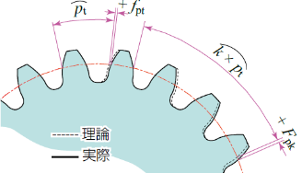
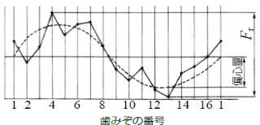
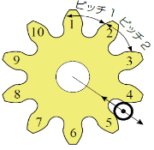
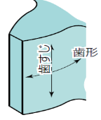
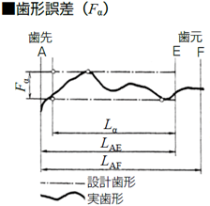
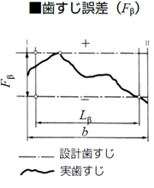
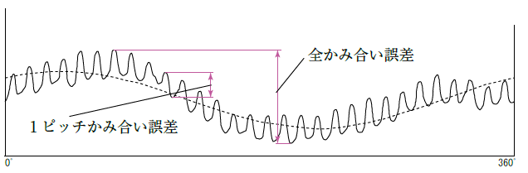
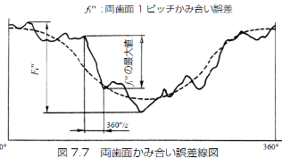
Precision of gears
High-precision gears are gears with minimal shape error.
Involute tooth profile accuracy | arrow (mark or symbol) | Tooth Profile Accuracy
Accuracy of tooth surface dentition | arrow (mark or symbol) | tooth track precision
Accuracy of tooth/groove position
Tooth indexing accuracy | arrow (mark or symbol) | Single pitch accuracy
(Pitch accuracy) | arrow (mark or symbol) | Cumulative pitch accuracy
Variation in the radial position of the ball pressed into the tooth groove | arrow (mark or symbol) | Runout accuracy of tooth grooves
Pitch error
Measure the pitch on the measurement circumference centered on the gear axis.
(a) Single pitch error (fpt)
Difference between actual pitch and theoretical pitch
(b) Cumulative pitch error (Fp)
Measure and evaluate the total tooth pitch error. The full amplitude of the cumulative pitch error curve is the cumulative pitch error (for three pieces).
Tooth groove runout (Fr)
Press the measuring element (ball or pin) into all tooth grooves and measure the radial position of the measuring element. It is the difference between the maximum and minimum values of The runout of the tooth groove includes the eccentricity of the gear shaft
Tooth flank meshing error (Fi″)
Tooth profile/pitch/thread accuracy, etc., were used to evaluate the accuracy of a single gear. Unlike this method, there is a gear accuracy evaluation method called the double tooth flank meshing test that evaluates gear accuracy by meshing with the parent gear (master gear). Engage the parent gear and the gear to be tested so that both tooth flanks are in contact with each other, rotate the gear to be tested by one revolution, and record the change in center distance. Figure 5.6 shows the test results for a gear with 30 teeth. 30 small peaks (waves) of 1-pitch meshing error can be seen. The total meshing error is It is about the size of the runout error of the tooth groove plus the size of the one pitch meshing error.
Tooth runout with 16 teeth
fi":1 pitch meshing error on both tooth flanks
Lα:Tooth profile inspection range
LAE: Length of engagement
LAF: useful length
Lβ: Tooth thread inspection range
b:Tooth width
Tooth flank meshing error diagram
Results of double tooth surface meshing test

Slide 10
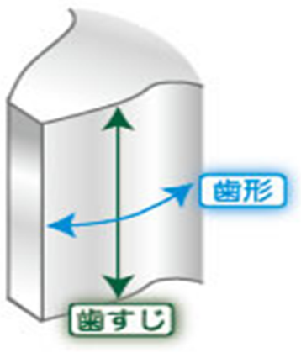
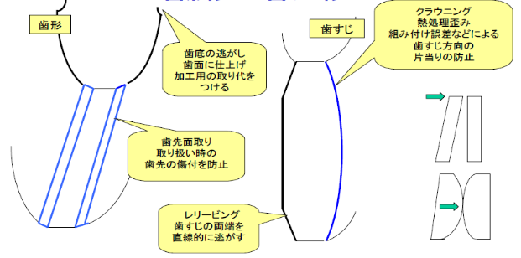
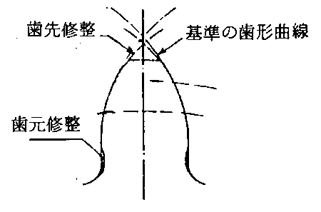

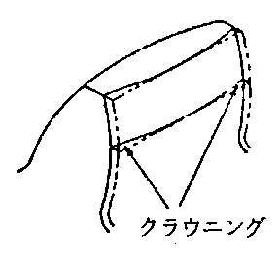
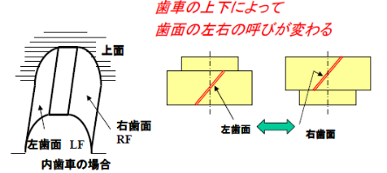
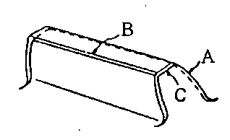
Tooth Profile and Tooth Stripe
Tooth Profile and Tooth Stripe Name
Tooth Profile Correction and Tooth Contour Correction
right tooth surface
(1) Tooth profile | Tooth Tip | Root
(2) Teeth stripes | Top | Bottom
(3) Tooth surface | Right tooth surface (RF) | Left tooth surface (Lf)
4) Twisting direction | Right Torsion (RH) | Left Torsion (LH)
Crowning heat treatment distortion
Prevention of uneven tooth contact in the tooth thread direction due to assembly errors, etc.
tooth-mark
tooth ridge
Tooth relief surface of the bottom of the tooth with a margin for finish machining
top
TOP
Left tooth surface
Prevents damage to tooth tips when handling chamfered tooth tips.
surface
Top
Straighten and release the ends of the releasing tooth line.
bottom of a tooth
Root
Torsion direction
point of a tooth
Tip.
Tooth Profile Correction (Fig. 14)
Tooth Profile Modification is a general term for tooth tip modification and tooth root modification.
Tooth tip correction means that the tooth shape at the tooth tip becomes more convex than the correct involute tooth shape.
The first step is to fix it to
lower part
Bottom
Crowning (Figure 15)
The gears are subject to the following problems: tooth stripe error, deviation of the parallelism of the axle holes in the gear box, tooth and
The deflection of the material causes the phenomenon of one-sided contact, which results in a reduction of the load capacity.
As shown in Figure (15), crowning is the process of creating a suitable bulge in the direction of the tooth muscle.
The gears that have been nailed down will not hit one side of the gear and will not lose their load capacity.
It also makes the gears sound much better. However, if too much crowning is applied, the sound per tooth will not be as good.
This can shorten the length of the cable and increase the noise level.
Figure 14.
TOP side of the two wheels
Transversely mounted engine Left side when riding
Vertical engine Forward direction side
Figure 15.
Chamfer (Figure 16)
Even a small scratch on the gears can often cause a bad sound, so it is important to have sharp edges around the gears.
There must be no To prevent bruising during transportation and assembly, there should be
Even if these parts hit the gears, they are not likely to gouge the gears.
All sharp corners should always be chamfered as shown in Figure (16).
Figure 16.

Slide 11









Materials and heat treatment of gears
Typical metal materials
S45C (Carbon Steel for Machine Structural Use)
S45C is a typical steel that contains a medium level of carbon (0.45%). It is a material that is very easy to obtain and is used in a variety of gears, including spur gears, helical gears, racks, bevel gears, and worm gears.
SCM440 (chromium molybdenum alloy steel)
Alloy steel containing moderate carbon (C = 0.40%) and components such as chromium/molybdenum Stronger material than S45C, hardened by tempering or induction hardening Used for various gears
Typical heat treatment
Hardening
This is a process in which the steel is heated to a high temperature (about 800°C) and then rapidly cooled in order to increase its hardness. Depending on the type of coolant, oil quenching, water quenching, or spray quenching is used. After quenching, steel is usually tempered to give toughness to over-hardened steel. Pure iron cannot be hardened by quenching, but iron containing more than 0.35% carbon can be hardened.
temperament
This is a heat treatment that combines quenching and tempering to adjust the hardness, strength, and toughness of steel. After tempering, the product is machined, so the hardness is not as high as quenching.
General heat treatment and hardness
Heat treatment | Hardness
None | 194HB or less
brutal | 200-270HB
High-frequency quenching | 50 to 60 HRC
General heat treatment and hardness
Heat treatment | Hardness
brutal | 225-285HB
High-frequency quenching | 50 to 60 HRC
High-frequency quenching
Steel containing more than 0.35% carbon, such as S45C or SCM440 (steel) Quenching method to harden the surface of In the case of induction hardening of gears, even though the tooth surface and the tooth tip can be made hard, it is not possible to achieve the same level of hardness. It may not be possible to make the bottom of the tooth harder. Hardness is lower than when carburized and quenched. High-frequency quenching reduces gear precision. Gear grinding is used to make high-precision gears.
Carburized quenching
Carbon is soaked into the surface of low carbon steel to create a high carbon state, and only the surface It is a heat treatment to harden The surface soaked with carbon becomes extra hard. Core (C=0.15% low carbon) It will also harden to some extent, but not as much as the surface. Carburized and quenched gears are deformed (dimension plus) and distorted, and their accuracy is It will be about the first grade worse. Gear grinding is necessary to increase the precision of gears.
SCM415 (chromium molybdenum alloy steel)
It is a representative of low carbon alloy steel (C=0.15%). It is generally used after carburizing and quenching. This material is stronger than S45C or SCM440. Surface hardness is used at about 55 to 60 HRC
SUS303 (Stainless steel: 18Cr-8Ni steel)
Stainless steel, as the name implies, is a steel that is resistant to rust. Austenitic stainless steel, essentially non-magnetic Used for gears in food machinery, etc., to prevent rusting. There is another stainless steel with similar composition called SUS304, which has better corrosion resistance than SUS303.
Copper alloy castings
It is often used as a material for worm wheels. Phosphor bronze casting (CAC502) and aluminum bronze (CAC702) are commonly used. The mating worm uses iron-based metal materials such as S45C/SCM440/SCM415. The reason for changing the material of the worm and worm wheel is to prevent galling and burning of the tooth surface due to slippage.
nitriding
This is a heat treatment in which nitrogen diffuses into the surface of the steel to make the surface harder. If the steel contains aluminum, chromium, or molybdenum, it is easily nitrided and becomes hard. A typical nitriding steel is SACM645 (Aluminum Chromium Molybdenum Steel).

Slide 12









Surface treatment of gears
Surface treatment is used to prevent rust and improve wear resistance.
Improved corrosion resistance/anti-corrosion effect Improved wear resistance Surface roughness improvement (smooth surface) Make the surface beautiful and clean | Caution. 1. no lubrication operation is possible even if wear resistance is improved 2. Plating on quenched and hardened gears makes them brittle. 3. Gear precision and dimensional accuracy deteriorate depending on the thickness of the plating.
Raydent Processing Great anti-corrosion effect/improved wear resistance. Black in color. Raydent is a registered trademark of Raydent Industries. A chrome raydent film (1 to 2 μm) that is very difficult to peel off is created on the surface by a process similar to plating.
Parker treatment (phosphate treatment) Ferric Phosphate Conversion Treatment. Iron phosphate film is a thin amorphous film that is used as a coating base for indoor painted products.
◇Palpos M This is a manganese phosphate passivate. The plating thickness is about 3 to 15 μm. It is also used as an anti-corrosion coating, and is used for sliding parts due to its excellent wear resistance.
Solid lubricant treatment Dry coat spray is a solid lubricant treatment that provides lubrication to the process that is impossible with oil. The lubricant adheres and dries simply by spraying on the tooth surface of the gear, and the molybdenum disulfide contained in the formula prevents wear caused by micro abrasion. It is effective in preventing fretting corrosion and initial blending.
WPC processing Effective for improving fatigue strength and sliding properties of metals Improves fatigue strength, not bending strength Ultra-small shots (40-200µm) are injected into the gears at a high speed of over 100m/sec. This generates instantaneous heat, which melts the metal crystals on the surface and rapidly cools them, resulting in thinner metal crystals. The dimensional change is about 1 to 2 microns.
Electrogalvanization Typical plating methods for rust prevention on iron Advances in chromate treatment have improved appearance and performance. Plating thickness is generally about 2 to 2.5 μm.
◇Unichromate Surface treatment not RoHS compliant. Silvery white with bluish tinge. Anti-corrosion performance is better than other zinc plating. For RoHS compliance, trivalent chromate (trivalent white) is used. Specify
◇Black chromate Surface treatment is not RoHS compliant. Black, but with a slight reddish tinge depending on the shape. For RoHS compliance, specify trivalent chromate (trivalent black).
Electroless nickel plating (Kanizen plating) Improves corrosion/abrasion resistance. Non-electrical plating. Plating thickness (3-10µm) is uniform and suitable for [complex shapes] and [strict dimensional accuracy].
Black Dye Alkaline black oxide coloring. The strong alkaline treatment solution is heated to 140℃ to make the metal black by its own chemical change. Anti-corrosion effect. A film of tetroxide with a thickness of less than 3 μm is formed on the surface.

Slide 13






Strength of gears
The gear designer also determines the specifications of the gear based on the load acting on the gear, the number of revolutions, and the expected life time. Here is a brief explanation of the bending strength and tooth surface strength as the strength of gears.
Formula for calculating the bending strength of spur and helical gears JGMA401-01 (Japan Gear Manufacturers Association)
If a force is applied to the tooth that exceeds the limit, the tooth will break from the basal veneer as shown in the figure.
Formula for calculating tooth surface strength of spur and helical gears JGMA402-01
The tooth surface strength is based on the contact stress on the tooth surface against tooth surface damage (pitching). Calculate the strength
Increase the bending strength.
Decrease the denominator and increase the numerator in the formula for allowable circumferential force (7.1). a) Use strong materials (increase allowable tooth root bending stress) b) Larger gears (larger module/ wider tooth width) c) Use a strong tooth profile (reduce the tooth profile coefficient). Large pressure angle ・Positive dislocation d) Increase the engagement ratio (reduce the load distribution coefficient). Increase the number of teeth ・Make helical gears e) Make it highly accurate.
Increase the tooth surface strength.
a) Use hardened and quenched materials (large allowable Hertzian stress). b) Larger gears (larger pitch circle diameter/ wider effective tooth width) c) Increase the engagement ratio (decrease the engagement ratio coefficient). d) Make it highly accurate.

Slide 14







Types of gear machining
Tooth cutting (rough cutting)
Tooth surface finish
Tooth surface finish (after heat treatment)
Hob (HOB)
Gear shaper (GS)
Shaving (SV)
Gear honing (G/HO)
Dental Laboratory (GG)
Internal Grinding Wheel
whetstone
HOB Cutter
pinion cutter
shaving cutter
work
work
work
work
work

Slide 15







Machining of gears (hobbing)
(1) Name of each part of the cutter
(2) Tooth profile of special hob
hob
hob
hob
semi-topping
topping
cog-wheel
cog-wheel
Protuberance
cog-wheel
Semi-Topped Hobs
topping fob
Pre-shaving hob
(3) Cutting feed direction
When cutting gears with a hob, the hob is moved from above to below the gear material.
There are conventional cuts and climb cuts that are sent upward from below.
In conventional cutting, the direction of rotation of the hob and the direction of feed are the same.
As a result, chips are removed from the bottom of the tooth toward the end of the tooth.
For this reason, the chips are thin at first, but gradually become thicker and come out.
This can lead to damage to the tooth surface and adhesion to the cutting edge of the hob.
In climb cutting, the rotation of the hob and the feed are in opposite directions, so the scrap
is the opposite of conventional cutting, which results in a good tooth cutting surface.
In addition, since there is no slippage until the beginning of hobbing, there is no friction. Also, since there is no slippage until the beginning of the hobbing process, there is no friction.
This reduces the risk of damage to the cutting edge and extends the life of the hob.
Advantages. For hard materials and high speed cutting, the climb cut
is good.

Slide 16







Gear processing (gear shaper processing)
(1) Name of each part of the cutter
(2) Tooth cutting principle and characteristics of pinion cutter
(3) Features of pinion and hob tooth cutting
In the meshing motion of a pair of gears, one is
Replace with a gear cutting tool (pinion cutter), and then replace with a gear cutting tool.
Rotational movement to ensure correct meshing of wheel materials
In this way, the pinion cutter can be moved back and forth in a reciprocating motion.
The tooth profile is created by This method is used for pinion cutters.
The first step is to cut the teeth by the
= Advantage.
1) Stepped gears and internal gears can be machined.
2) Gear cutting of special gears (missing teeth, coupled teeth)
Engineering is possible.
3) Relatively low cost of tools
= Disadvantage =
1) Processing time is longer than that of hobbing.
2) Less processing per reg.
3) Large changes in the workpiece tooth base diameter and chamfering amount
Tooth cutting method |  |  | Reciprocating motion + rotation (gear shaper) | Rotation + rotation (hob)
 |  |  | In the meshing motion of a pair of spur gears, the tooth profile is created by reciprocating the cutter while causing the cutter and blank to move in a rotational motion so that they mesh correctly. | This is a tooth-cutting method in which the hob is rotated and the corresponding rotation is given to the blank to create a tooth profile, and the cutter and blank both rotate continuously in one direction to index the number of teeth and create the tooth profile simultaneously.
symmetrical gear | external gear |  | 'correct' (when marking) | 'correct' (when marking)
 | stepped gear |  | 'correct' (when marking) | x-mark (used to indicate an incorrect answer in a test, etc.)
 | internal gear |  | 'correct' (when marking) | x-mark (used to indicate an incorrect answer in a test, etc.)
Machining accuracy | surface of a tooth | Roughness | small | big
 |  | Cutting eyes
 | Pitch error |  | big | small
Features |  |  | One of the characteristics of the gears cut by the gear shaper is that each tooth on the circumference of the pinion cutter finishes the corresponding tooth on the gear, so the accuracy of the cutter is directly reflected in the gear. In addition, the reciprocating motion increases the cutting load, resulting in lower accuracy and lower machining efficiency than hobs. It is generally used as a substitute for a hob when machining stepped gears and internal gears that cannot be hobbed. | Since each tooth on the circumference of the gear is cut in the same way by the same cutting edge of the hob, the precision error of the hob cutter causes the same error in each tooth of the gear, resulting in the production of uniform gears with no discontinuities. The pitch error of the product is rarely affected by the cutter accuracy. Cutting is done by rotary motion, which reduces the cutting load and allows for highly efficient machining. It is generally used as a standard tooth cutting method because of its superior accuracy and productivity.
pinion cutter
hob
Foundation screw surface
machined gear
virtual gear
projection contour
(Cutting Rack)
machined gear
Cutting teeth on pinion cutter

Slide 17









Machining of gears (shaving process)
(1) Name of each part of the cutter
(2) Shaving method
Shaving method | conventional | (roadway) underpass | diagonal | plunge cut
Purpose | The most common machining method, suitable for machining gears with wide tooth widths and large gears. | Suitable for mass production of gears with a width slightly wider than the cutter width. | Used in the machining of stepped gears, etc. | Suitable for highly efficient machining of mass-produced gears.
Machining time (Reference) m3 PA20°NT30 Width 20 Gears are machined 3 times ( ): 2 times | 95-100″. (65-70″) | 60-65″. (40-45″) | 60-65″. (40-45″) | 25-30″.
Features | Feed the gear axially. The feed length is almost the same as the tooth width of the gear. | Feeding at an angle to the gear axis The feed length is shorter than the gear tooth width. | Feed perpendicular to the gear axis The feed length is shorter than the two directions shown on the left. Differential serration | In-feed only Differential serration
Outline drawing

Slide 18












Machining of gears (gear gliding)
(1) Theory of gear grinding
(2) Dressing device
(3) Tooth phase alignment
Types of Diamond Dressing Tools
Grinding wheels and flanges
Grinding wheels
(Unprocessed)
rotary dresser
Pitch feed.
NC of dress infeed axis
Auto-dressable with control
Grinding wheels
dressed up
(4) Grinding wheels
WA (White Aluminum Oxide) grinding wheel with alumina abrasive grains is commonly used.
It is also called WA tooth grinding.
Recently, Norton's ceramic grinding wheels (SGF) are being used for high-efficiency grinding.
It is used in the following ways
WA: Raw materials such as bauxite and white alumina are melted in a furnace and solidified.
It is made by crushing and arranging a mass that has been It has an overall white color.
Abrasive grains have extremely large crystals growing on them.
SGF: Manufactured by a chemical process called Seeded Gel
This is done by starting with submicron-sized particles of the main raw material and then drying them. This is done by starting with sub-micron sized particles of the main raw material and then drying it.
In this way, the refined abrasive grains can be used for the production of other products. Abrasive grains refined in this way are
It is a microcrystalline (submicron) ceramic body with high Al2O3 purity. One piece
There are billions of particles in the abrasive grains of
The result is a unique crushability (micro-crushing).
Unlike WA's intergranular crushing and macro-crushing, micro-crushing provides a stable and sharp
Ensure the state.
X Radial infeed axis
Grinding wheel flange
Worm-shaped grinding wheel corresponds to the pressure angle of the rack tooth profile or grinding gear
The rack teeth of the grinding wheel have a straight two-sided tooth profile. The rack teeth of this grinding wheel are used to grind the
Involute creation is performed by engaging the gears.
Gear grinding is performed while the gears are being ground.
Advantages - Low cumulative pitch error
Stability of tooth shape and tooth muscle system
With flange
Grinding wheels

